Slide 1
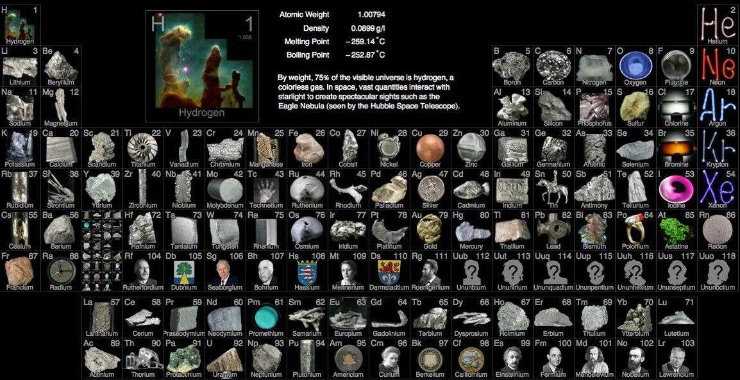
The Elements! Finally!!
Yaaasssss

Slide 2
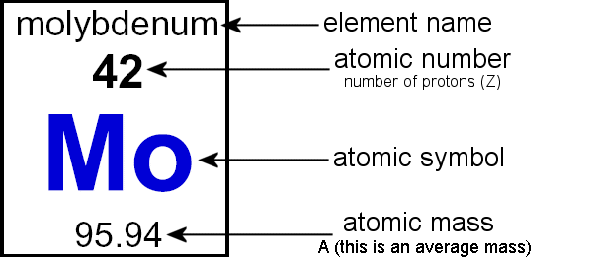
What is an Element?

Slide 3
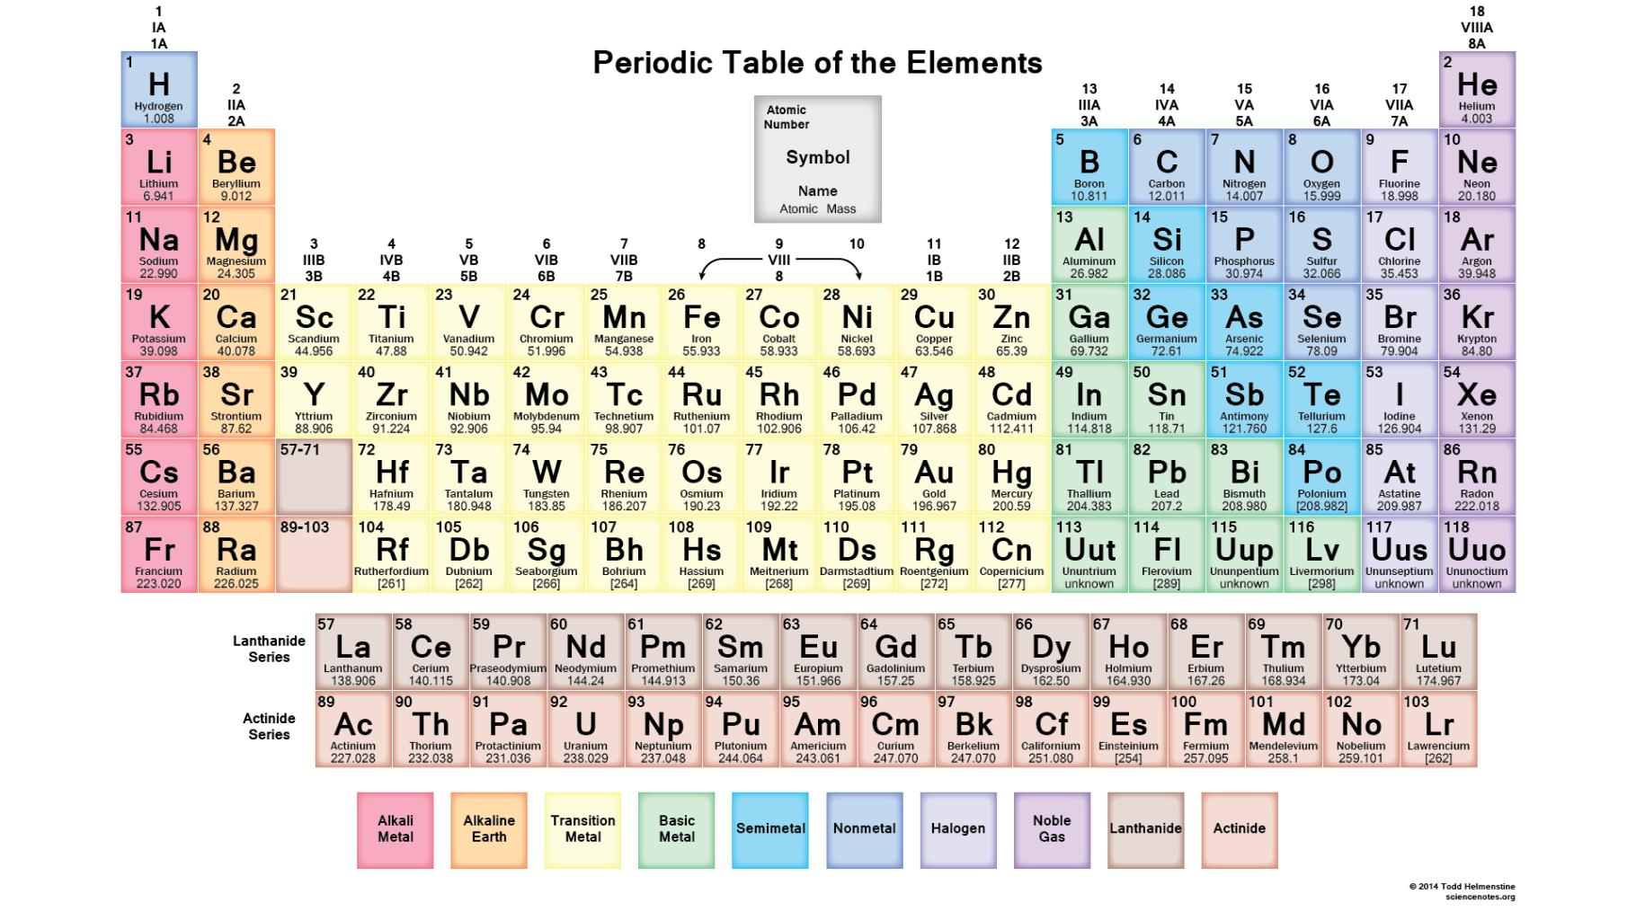
What is an Element?

Slide 4
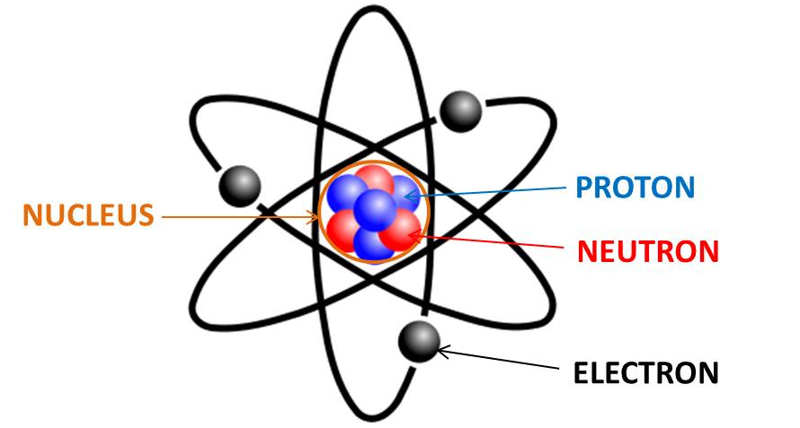
Atom: The basic unit of a chemical element.

Slide 5
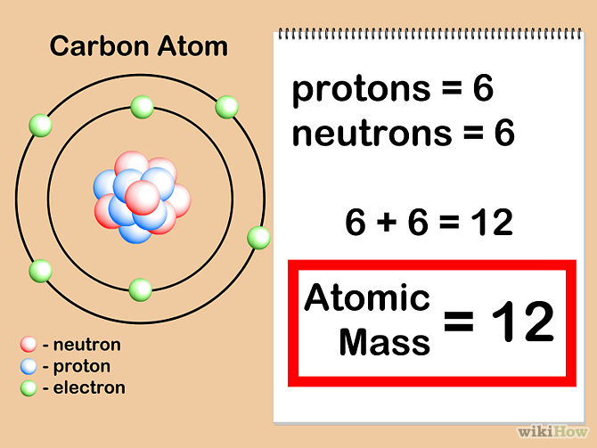
Atomic mass: The number of protons AND neutrons in an atom

Slide 6
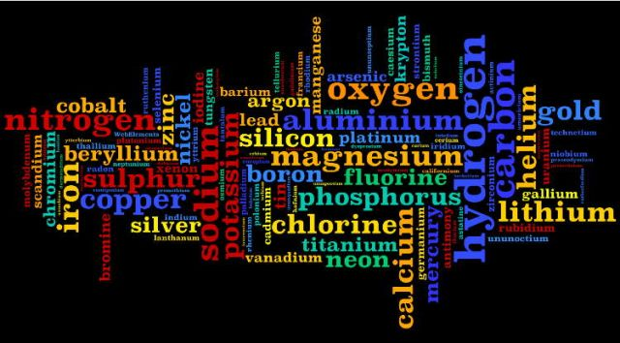
Element: A tiny piece of matter that cannot be made smaller.

Slide 7
Metal: A solid material that is typically hard, shiny, malleable, fusible, and ductile, with good electrical and thermal conductivity
Do Now: List as many metals as you can in 3 minutes. GO!!

Slide 8
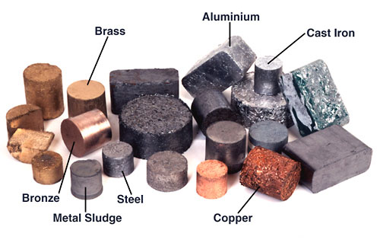
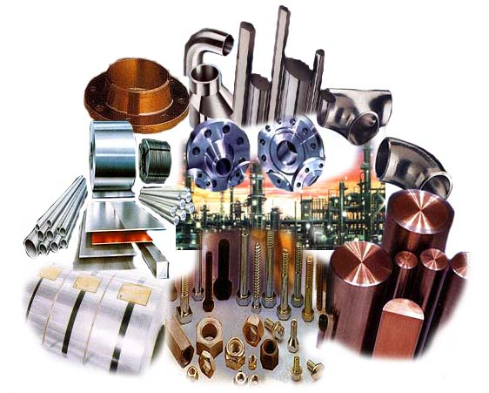
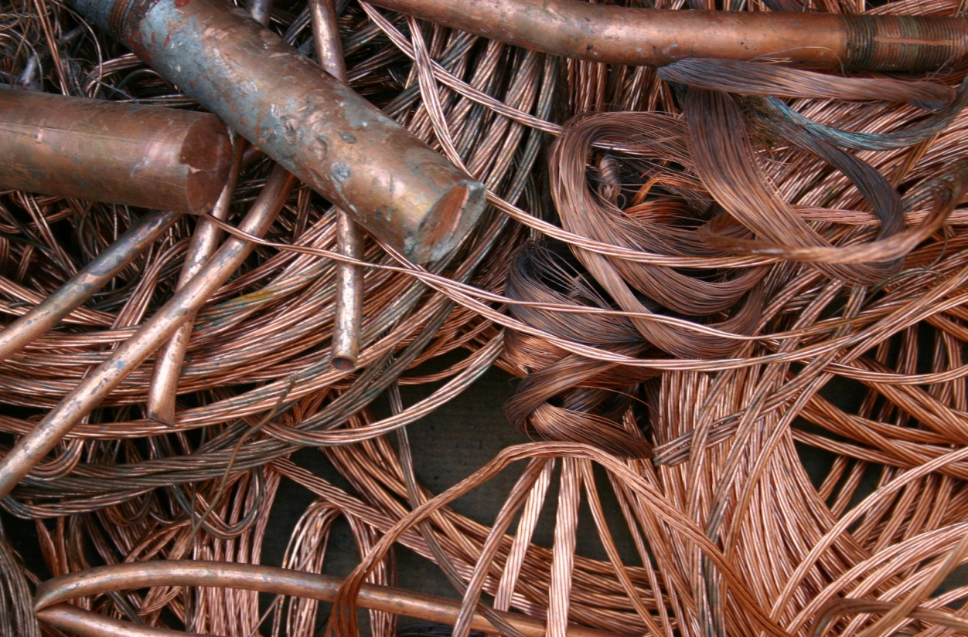

Slide 9
In your SEPUP book, turn to page B-19 and read the Challenge Question.
How can elements be grouped based on their physical and chemical propeties?

