Slide 1
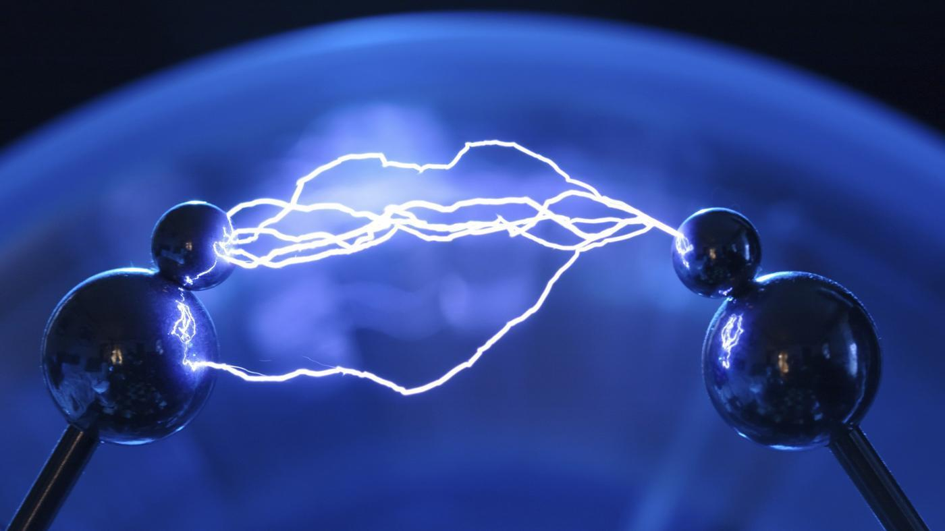
Atomic Charges: 12 / 7 / 15

Slide 2
We need a little review first...
Take a few minutes and draw the Lewis Structure for the following element:
C
Cl
B
Mg
Ne

Slide 3
We need a little review first...
Take a few minutes and draw the Lewis Structure for the following element:
C
Cl
B
Mg
Ne

Slide 4
We need a little review first...
Can someone remind me how many electrons can be held in each shell for an atom?

Slide 5
We need a little review first...
Can someone remind me how many electrons can be held in each shell for an atom?
8
8
2

Slide 6
So besides the first shell, the others can all hold 8 electrons. There is a special name for this...
8
The Octet Rule
8
2

Slide 7
The Octet Rule: Atoms want to have a complete outer shell at all times.
8
8
2
Since most the atoms the first shell (2), we call it the octet rule (8)

Slide 8
Let's take a look at Chlorine:
How many valence electrons?
Cl
How many more electrons until it fills its shell?

Slide 9
Let's take a look at Chlorine:
Would it be easier to find one more electron, or get rid of seven. Hint* atoms are lazy ;)
Cl

Slide 10
Let's take a look at Chlorine:
Would it be easier to find one more electron, or get rid of seven. Hint* atoms are lazy ;)
Cl

Slide 11
Let's take a look at Sodium:
Would it be easier to find one more electron, or get rid of seven. Hint* atoms are lazy ;)
Na

Slide 12
Let's take a look at Chlorine:
Cl
So since chlorine wants to gain 1 electron, he becomes more negative.

Slide 13
Let's take a look at Chlorine:
Cl
This makes chlorine have a -1 charge.

Slide 14
Let's look at some others:
Mg
Ne
S
C

Slide 15
Let's look at some others:
0
Mg
+2
Ne
-2
S
C
***

Slide 16
What's so special about Neon and the other atoms in its column:
Ne

Slide 17
Let's get our tables labeled:

