Slide 1
How to Read the Periodic Table

Slide 2
6
Atomic Number
C
Atomic Symbol
CARBON
Name
12.011
Atomic Mass
(Weight)

Slide 3
Atomic Number: The number of PROTONS in an atom
6
Atomic Number
C
Atomic Symbol
CARBON
Name
12.011
Atomic Mass
(Weight)

Slide 4
Find the atomic number for the following atoms:
1. Copper
2. Silver
3. Helium
4. Boron
5. Gold
6. Vanadium
7. Uranium
8.Xenon
Atomic Number: The number of PROTONS in an atom

Slide 5
Atomic Symbol: The one or two letter abbreviation for an element.
6
Atomic Number
C
Atomic Symbol
CARBON
Name
12.011
Atomic Mass
(Weight)

Slide 6
Atomic Mass: The number of protons AND neutrons in an atom
6
Atomic Number
C
Atomic Symbol
CARBON
Name
12.011
Atomic Mass
(Weight)

Slide 7
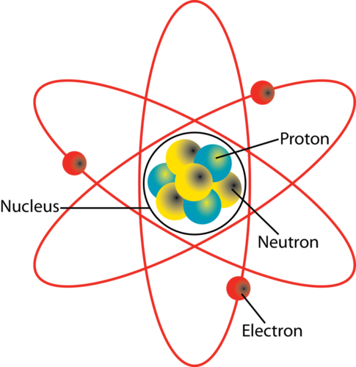
The Parts of an Atom

Slide 8
Nucleus: The dense center of an atom. Contain protons and neutrons.

Slide 9
Proton: The positive part of the atom. Also the atomic number

Slide 10
Nuetron: The neutral part of the atom.

Slide 11
Electron: The negative part of the atom. Found outside of the nucleus.

