Slide 1
Valence Electrons and Lewis Structures:
November 9th, 2015

Slide 2
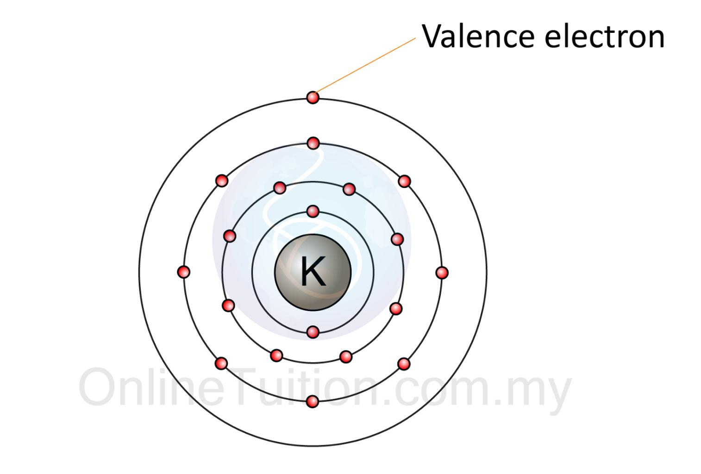
Valence Electron: The electrons in the outer most shell of an atom.

Slide 3
How do we find the number of Valence Electrons for an atom?
Step 1: Draw the Bohr Diagram.
Cl

Slide 4
How do we find the number of Valence Electrons for an atom?
Step 2: How many electrons are in the outmost shell?
Cl

Slide 5
How do we find the number of Valence Electrons for an atom?
Step 3: You're Done!!
Cl

Slide 6
Your turn - Find the number of valence electrons for the following atoms
Lithium
Magnesium
Boron
Sulfur
Chlorine
Aluminum
Beryllium
Argon
Oxygen
Carbon

Slide 7
Your turn - Find the number of valence electrons for the following atoms
Lithium - 1
Magnesium - 2
Boron - 3
Sulfur - 6
Chlorine - 7
Aluminum - 3
Beryllium - 2
Argon - 8
Oxygen - 6
Carbon - 4

Slide 8
Take a look - Check out the Bohr Diagram worksheet you did. Count the number of Valence Electrons and see if you notice any patterns....

Slide 9
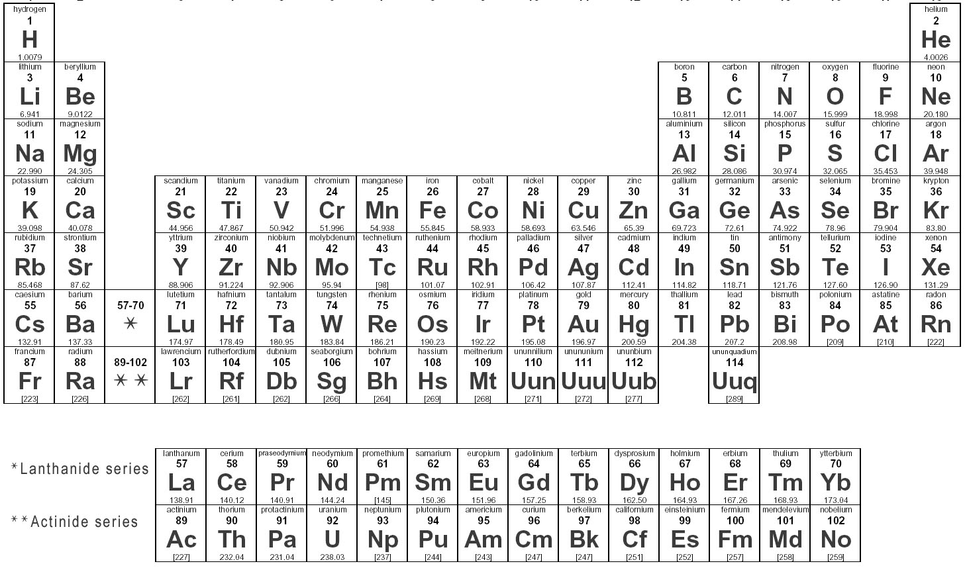
1
2
3
4
5
6
7
8

Slide 10
Lewis Structures:

Slide 11
Lewis Structures: A diagram that shows the valence electrons for an atom.

Slide 12
How Do I Create a Lewis Structure?
This will be a lot easier than Bohr Diagrams now that you have your Periodic Table all set up.
Step 1: Find the element on the periodic table.

Slide 13
How Do I Create a Lewis Structure?
Step 2: Find the number you wrote above that column. That's the number of valence electrons for that atom.

Slide 14
How Do I Create a Lewis Structure?
Step 3: Let's draw some dots. Follow the order below.
1
5
Ee
3
4
7
8
2
6

